Slide 1
CMPE 483 Camera-Movements Activity
Section: CMPE483-L01
Group members:
1. Osama aljindi
2. Abdullah zain
3. Jassim alansari
4. Mohammad sandouk

Slide 2
Code Logic
1. overall structure
This code is written in (Python 3) and uses standard libraries like (cv2), (time), (math), (signal), (threading), and (numpy), along with custom modules such as (common.pid), (common.misc), (common.yaml_handle), and (common.mecanum).
The purpose of the code is to track specific colors in a camera image using LAB color space, calculate their position, and drive the robot to follow them. The robot uses a camera to detect the color, and a (PID) controller adjusts its direction. The robot has a (mecanum) wheel chassis, allowing it to move in any direction.

Slide 3
Code Logic
Execution flow:
1. Initialize the robot and load configuration.
2. Start the camera stream.
3. Process video frames to detect colored areas.
4. Compute the center of the detected object.
5. Use (PID) control to adjust the robot's heading to follow the object.

Slide 4
Code Logic
2. modules and variables
- The variable (chassis) is an instance of (MecanumChassis) used to control movement.
- (pitch_pid) is an instance of the (PID) controller that handles rotational corrections.
- (range_rgb) is a dictionary mapping color names to their RGB values, used for drawing.
- (lab_data) holds color thresholds in LAB color space, loaded from a YAML configuration file using (yaml_handle).

Slide 5
Code Logic
3. setup functions
- (load_config) loads the LAB color ranges from a YAML file using (yaml_handle.get_yaml_data).
- (initMove) sets initial servo positions using (board.pwm_servo_set_position) and starts movement using (chassis.set_velocity).
- (init) runs both (load_config) and (initMove).
- (setTargetColor) sets the target colors that the robot should follow, such as 'red' or 'black'.

Slide 6
Code Logic
4. movement logic (move thread)
The (move) function runs in a background thread using (threading.Thread). It continuously monitors the detected horizontal position of the target ((line_centerx)) and adjusts the robot’s heading.
If the target is found ((line_centerx > 0)), it calculates the offset from the image center ((img_centerx)). If the offset is small, it sets the (pitch_pid.SetPoint) to that offset. Otherwise, it resets it to 0. The (pitch_pid.update) function processes the error and the (chassis.set_velocity) command applies the movement using the computed angle.
If no target is detected, the robot moves straight without turning.

Slide 7
Code Logic
5. image processing (run function)
The (run) function processes one frame of the video stream to determine the center of the detected color:
1. The image is resized using (cv2.resize) and blurred using (cv2.GaussianBlur).
2. It loops over three predefined regions of interest ((roi)), each with an assigned weight.
3. For each region: → → →
4. A weighted average of the detected centers is used to update (line_centerx), which is used by the movement logic.
Point 3 explanation:
- The image is converted to LAB using (cv2.cvtColor).
- A color mask is created using (cv2.inRange), based on values in (lab_data).
- The masks are combined using (cv2.bitwise_or).
- The result is cleaned using (cv2.erode) and (cv2.dilate).
- Contours are found using (cv2.findContours).
- The largest valid contour is extracted using (getAreaMaxContour).
- The bounding box and center are drawn using (cv2.drawContours) and (cv2.circle), with coordinate adjustments using (Misc.map).

Slide 8
Code Logic
6. main loop
The main loop continuously captures frames using (cv2.VideoCapture) and processes them:
- Each frame is passed to (run) for processing.
- The processed frame is resized and shown using (cv2.imshow).
- The loop exits if the Escape key is pressed ((cv2.waitKey)) or if the stream fails.
The video stream is expected to come from an IP camera or MJPEG server, such as one running on localhost.

Slide 9
Code Logic
7. control and signal handling
- (start) resets state and activates the system.
- (stop) deactivates the system and stops motion using (chassis.set_velocity).
- (exit) performs the same actions as (stop).
- (Stop) is a signal handler that stops the robot safely when a termination signal like Ctrl+C is received, registered using (signal.signal).

Slide 10
Code Logic
8. summary
(run) detects target colors and calculates their center in the frame.
(move) uses PID control to adjust the robot’s heading based on the detected position.
The main loop continuously captures and processes video frames.
(PID) ensures smooth and responsive control over turning.
(MecanumChassis) allows the robot to move in any direction.
Color detection thresholds are loaded from configuration using (yaml_handle).

Slide 11
Code
import sys
sys.path.append('/home/pi/MasterPi/')
import cv2
import time
import math
import signal
import Camera
import threading
import numpy as np
import common.pid as PID
import common.misc as Misc
import common.yaml_handle as yaml_handle
import common.mecanum as mecanum
from kinematics.transform import *

Slide 12
chassis = mecanum.MecanumChassis()
pitch_pid = PID.PID(P=0.0009, I=0.000002, D=0.0003)
range_rgb = {
'red': (0, 0, 255),
'blue': (255, 0, 0),
'green': (0, 255, 0),
'black': (0, 0, 0),
'white': (255, 255, 255),
}
if sys.version_info.major == 2:
print('Please run this program with python3!')
sys.exit(0)
def setTargetColor(target_color):
global __target_color
__target_color = target_color
return (True, ())
lab_data = None

Slide 13
def load_config():
global lab_data
lab_data = yaml_handle.get_yaml_data(yaml_handle.lab_file_path)
def initMove():
board.pwm_servo_set_position(0.8, [[1,2500],[3,500],[4,2500],[5,1261],[6,1500]])
chassis.set_velocity(0,90,0)
line_centerx = -1
def reset():
global line_centerx
global __target_color
line_centerx = -1
__target_color = ()
def init():
load_config()
initMove()
__isRunning = False
def start():
global __isRunning
reset()
__isRunning = True
def stop():
global __isRunning
__isRunning = False
chassis.set_velocity(0,90,0)

Slide 14
def exit():
global __isRunning
__isRunning = False
chassis.set_velocity(0,90,0)
def getAreaMaxContour(contours):
contour_area_max = 0
area_max_contour = None
for c in contours:
contour_area_temp = math.fabs(cv2.contourArea(c))
if contour_area_temp > contour_area_max:
contour_area_max = contour_area_temp
if contour_area_temp >= 5:
area_max_contour = c
return area_max_contour, contour_area_max
img_centerx = 320
line_centerx = -1

Slide 15
def move():
global line_centerx
while True:
if __isRunning:
if line_centerx > 0:
num = line_centerx - img_centerx
if abs(num) < 25:
pitch_pid.SetPoint = num
else:
pitch_pid.SetPoint = 0
pitch_pid.update(num)
angle = pitch_pid.output
chassis.set_velocity(25, 90, -angle)
time.sleep(0.1)
else:
chassis.set_velocity(0, 90, 0)
time.sleep(0.2)
else:
time.sleep(0.01)
th = threading.Thread(target=move)
th.daemon = True
th.start()
roi = [
(240, 280, 0, 640, 0.1),
(340, 380, 0, 640, 0.3),
(430, 460, 0, 640, 0.6)
]
roi_h1 = roi[0][0]
roi_h2 = roi[1][0] - roi[0][0]
roi_h3 = roi[2][0] - roi[1][0]
roi_h_list = [roi_h1, roi_h2, roi_h3]
size = (640, 480)

Slide 16
def run(img):
global line_centerx
global __target_color
img_copy = img.copy()
img_h, img_w = img.shape[:2]
if not __isRunning or __target_color == ():
return img
frame_resize = cv2.resize(img_copy, size, interpolation=cv2.INTER_NEAREST)
frame_gb = cv2.GaussianBlur(frame_resize, (3, 3), 3)
centroid_x_sum = 0
weight_sum = 0
center_ = []
n = 0
for r in roi:
roi_h = roi_h_list[n]
n += 1
blobs = frame_gb[r[0]:r[1], r[2]:r[3]]
frame_lab = cv2.cvtColor(blobs, cv2.COLOR_BGR2LAB)
frame_mask_total = np.zeros((blobs.shape[0], blobs.shape[1]), dtype=np.uint8)
for i in __target_color:
if i in lab_data:
mask = cv2.inRange(frame_lab, tuple(lab_data[i]['min']), tuple(lab_data[i]['max']))
frame_mask_total = cv2.bitwise_or(frame_mask_total, mask)
eroded = cv2.erode(frame_mask_total, cv2.getStructuringElement(cv2.MORPH_RECT, (3, 3)))
dilated = cv2.dilate(eroded, cv2.getStructuringElement(cv2.MORPH_RECT, (3, 3)))
cnts = cv2.findContours(dilated, cv2.RETR_EXTERNAL, cv2.CHAIN_APPROX_TC89_L1)[-2]
cnt_large, area = getAreaMaxContour(cnts)
if cnt_large is not None:
rect = cv2.minAreaRect(cnt_large)
box = np.intp(cv2.boxPoints(rect))
for i in range(4):
box[i, 1] = box[i, 1] + (n - 1) * roi_h + roi[0][0]
box[i, 1] = int(Misc.map(box[i, 1], 0, size[1], 0, img_h))
for i in range(4):
box[i, 0] = int(Misc.map(box[i, 0], 0, size[0], 0, img_w))
cv2.drawContours(img, [box], -1, (0, 0, 255, 255), 2)
pt1_x, pt1_y = box[0, 0], box[0, 1]
pt3_x, pt3_y = box[2, 0], box[2, 1]
center_x, center_y = (pt1_x + pt3_x) / 2, (pt1_y + pt3_y) / 2
cv2.circle(img, (int(center_x), int(center_y)), 5, (0, 0, 255), -1)
center_.append([center_x, center_y])
centroid_x_sum += center_x * r[4]
weight_sum += r[4]
if weight_sum != 0:
line_centerx = int(centroid_x_sum / weight_sum)
cv2.circle(img, (line_centerx, int(center_y)), 10, (0, 255, 255), -1)
else:
line_centerx = -1
return img

Slide 17
def Stop(signum, frame):
global __isRunning
__isRunning = False
chassis.set_velocity(0, 90, 0)
if __name__ == '__main__':
from kinematics.arm_move_ik import *
from common.ros_robot_controller_sdk import Board
board = Board()
AK = ArmIK()
AK.board = board
init()
start()
signal.signal(signal.SIGINT, Stop)
cap = cv2.VideoCapture('http://127.0.0.1:8080?action=stream')
__target_color = ('black', 'red')
while __isRunning:
ret, img = cap.read()
if ret:
frame = img.copy()
Frame = run(frame)
frame_resize = cv2.resize(Frame, (320, 240))
cv2.imshow('frame', frame_resize)
key = cv2.waitKey(1)
if key == 27:
break
else:
time.sleep(0.01)
cv2.destroyAllWindows()

Slide 18
..\OneDrive\Desktop\LineTracking.py
This is the file of the full code

Slide 19
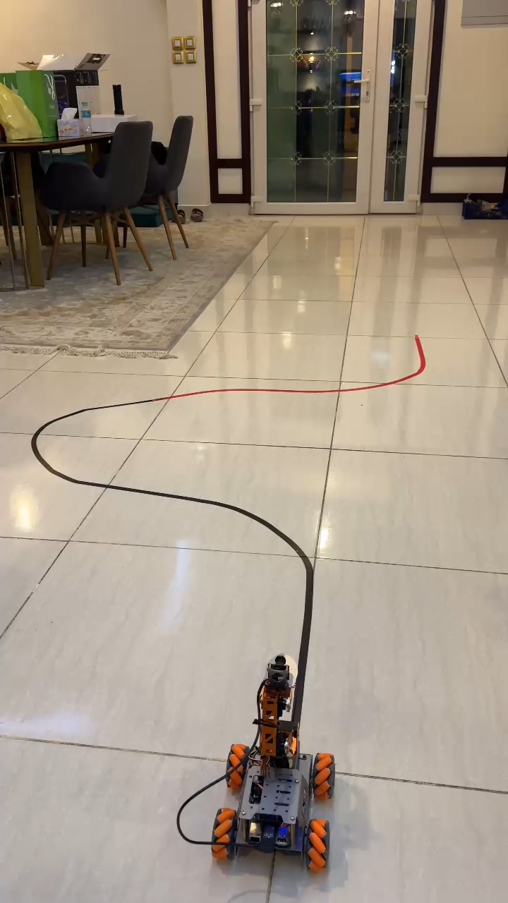
Video

